Slide 1

ALGORITHM DESIGN AND
DATA STRUCTURES
Haiying Xiao
SET 2430 - Fall 2026

Slide 2
Course Overview
2
Introduction
・Data structure: method to store information
・Algorithm: method for solving a problem.
Class Schedule: Wednesday 9:00AM - 10:40AM & Thursday 9:00AM - 10:40AM
Location: Wednesday: Online-Zoom Thursday: V-610 or Online
Office hour: every Thursday from 11:00 AM to 12:00 PM Location: V-610 or online

Slide 3
3

Slide 4

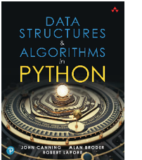
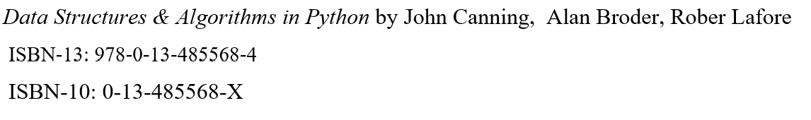

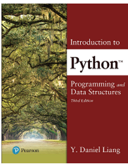
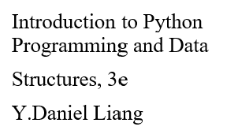

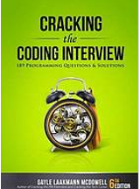
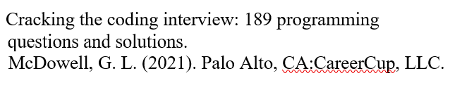
Text Book
Editor/IDLE
https://vscode.dev/

Slide 5

Topic Area | Core Topics
Data Structures | Arrays, Lists, Stacks, Queues, Priority Queues
Algorithm Analysis | Algorithm comparison, best/worst/average cases, Big-O notation
Sorting | Insertion Sort, Mergesort, Quicksort, Radix Sort
Searching & Dictionaries | Binary Search Trees (BST), Hash Tables
Trees | Binary Trees, Tree Traversals, Binary Search Trees
Graphs | Graph Representations, BFS, DFS, Shortest Paths, Minimum Spanning Trees (Prim, Kruskal)
Applications & Review | Practical problem solving, review, and final assessment
Why study algorithms?

Slide 6








Algorithms and data structures are the foundation of modern software.
They power technologies we use every day:
Web search and recommendations
Social media feeds
Online shopping and payments
Maps, navigation, and routing

Slide 7

Real-World Impact
(Everywhere You Look)
Algorithms are behind major advances in:
Internet & Web: search engines, routing, distributed systems
Graphics & Media: video games, movies, image & video compression
Security: encryption, e-commerce, authentication
Science & Engineering: genome analysis, simulations, modeling
Without efficient algorithms, these systems would be too slow or impossible.

Slide 8
Industry & Careers
Top companies expect strong fundamentals in algorithms and data structures:
Google — search ranking, large-scale data processing
Apple — system performance, mobile applications
Amazon — recommendations, logistics, cloud systems
Microsoft — operating systems, cloud platforms
Meta (Facebook) — social graphs, feeds, ads
IBM, Oracle, Cisco — databases, networks, enterprise systems
Why It Matters for You
Studying algorithms helps you:
Write faster and more efficient code
Choose the right data structure for a problem
Solve problems that brute force cannot
Become a stronger programmer, not just a coder
“Good programmers worry about data structures and their relationships.”
— Linus Torvalds
This course gives you tools that last your entire career.

Slide 9
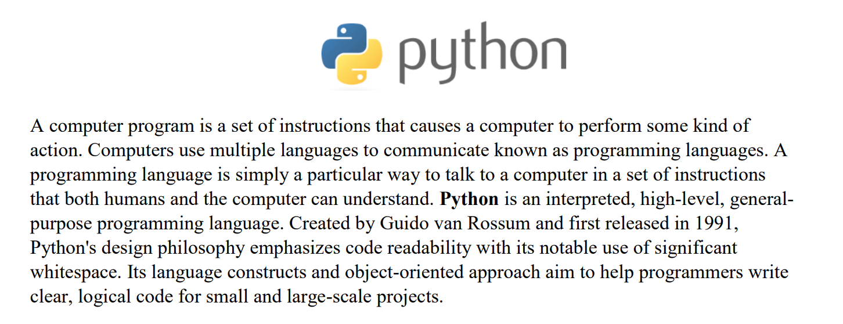
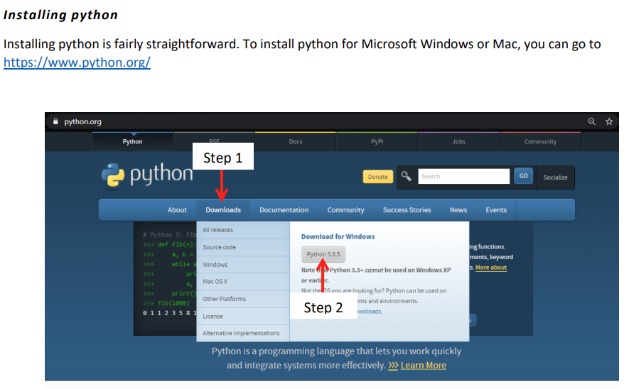
Set up a development
environment then
practice simple
Python exercises.

Slide 10
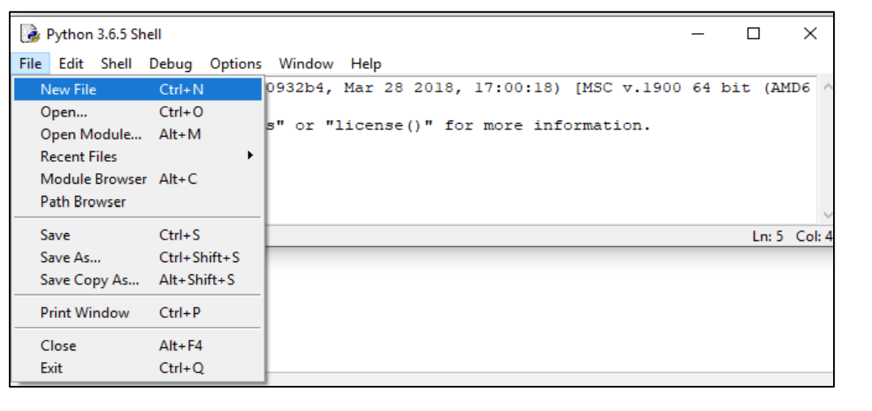
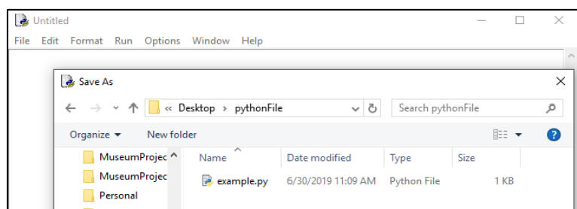
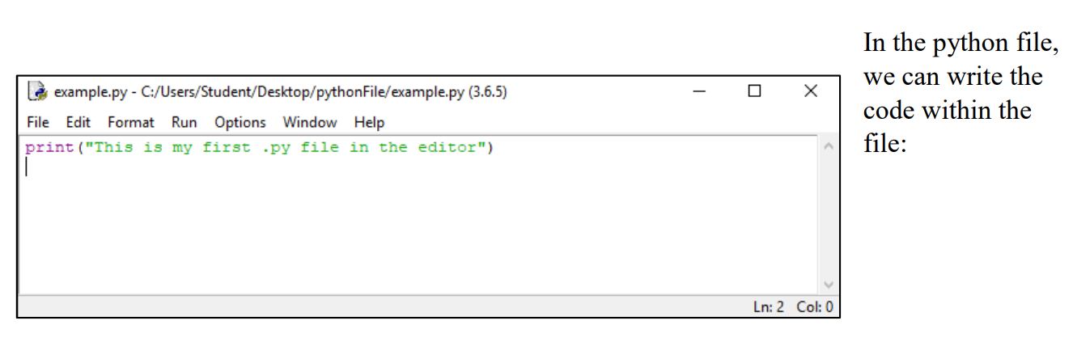

Slide 11

Review
Python syntax,
basic data types，
variables,
control flow,
and functions.

Slide 12
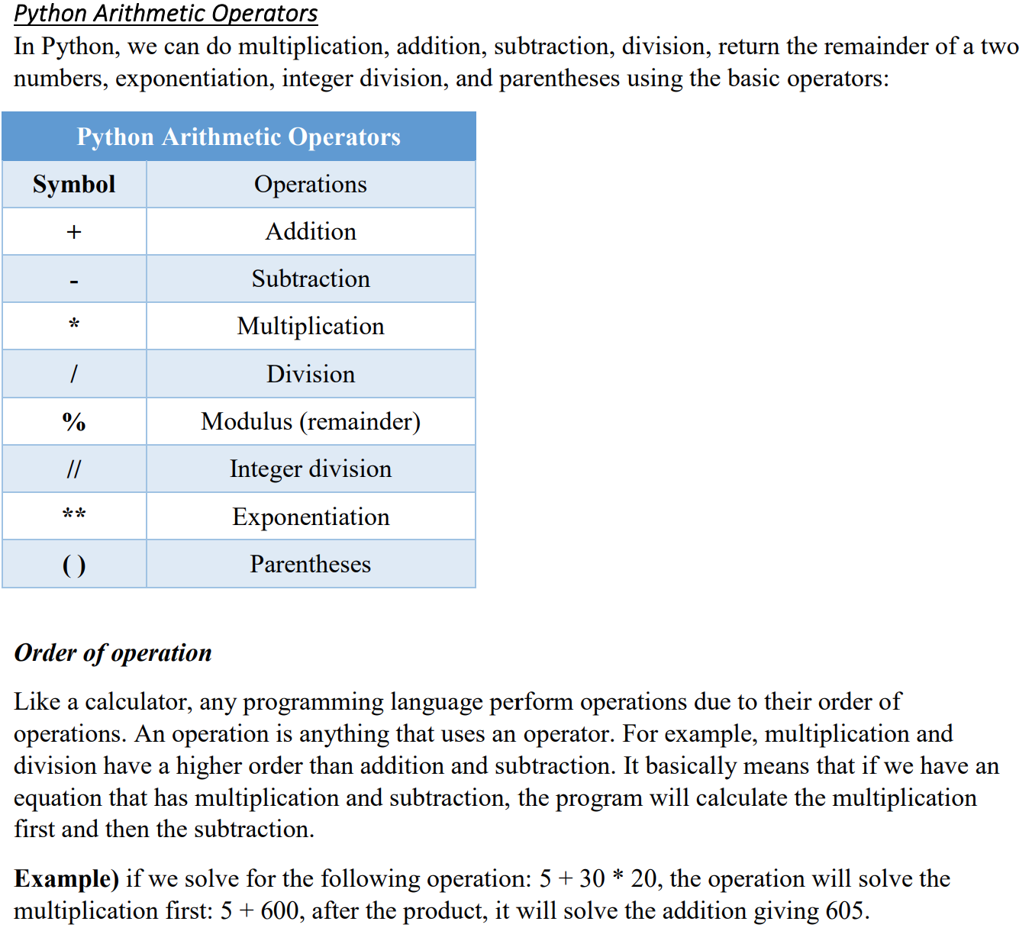
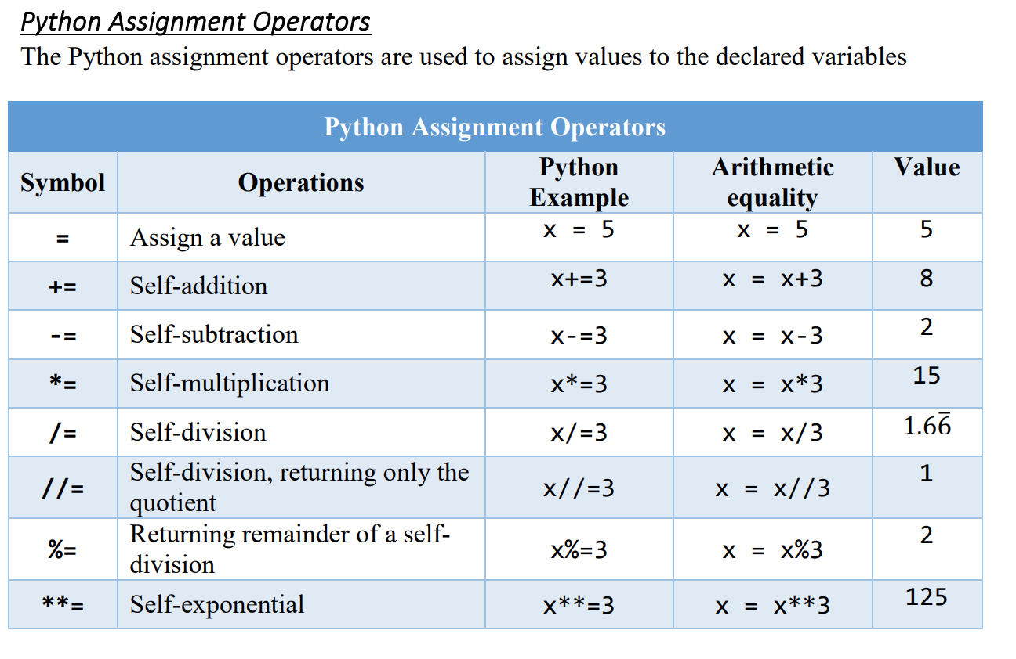
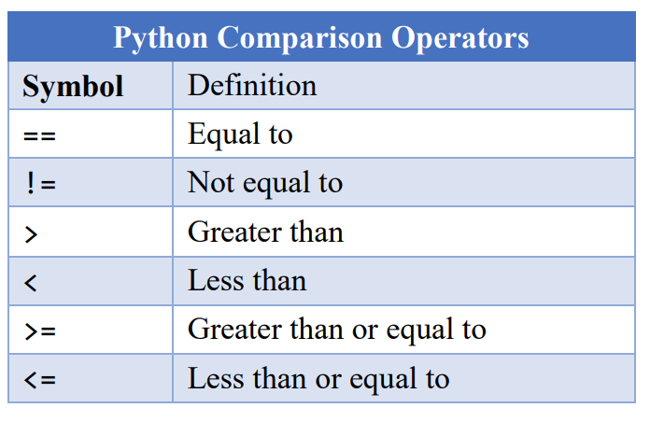
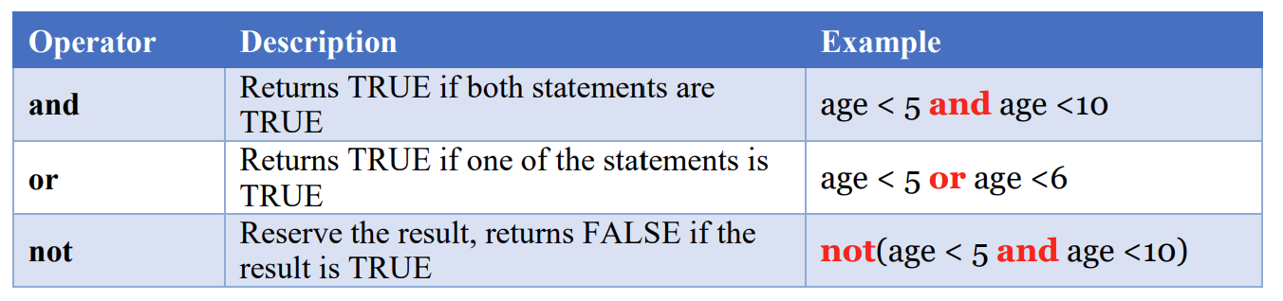
Operators
Python Logical Operator

Slide 13
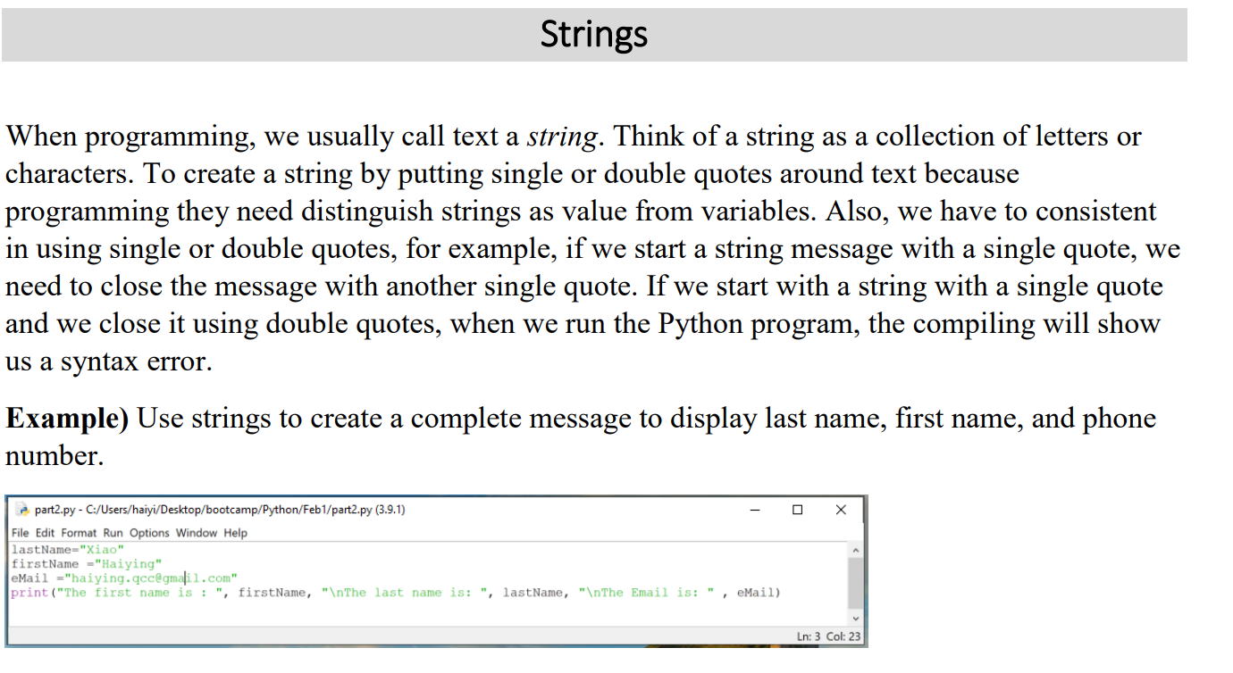

Slide 14
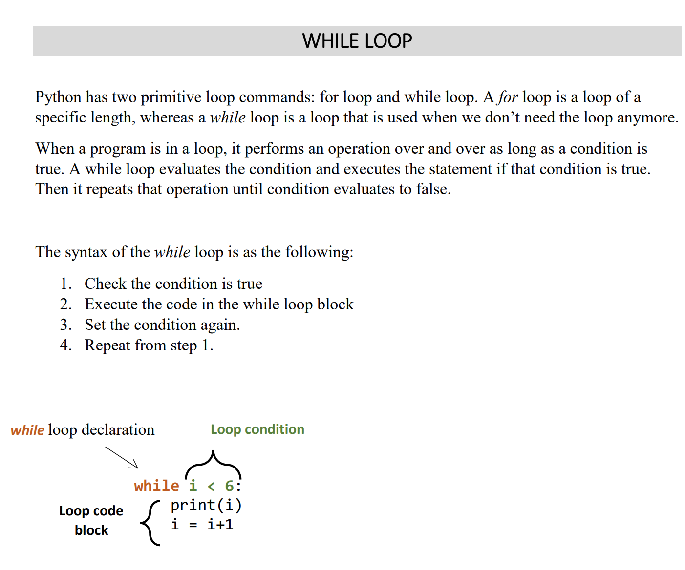
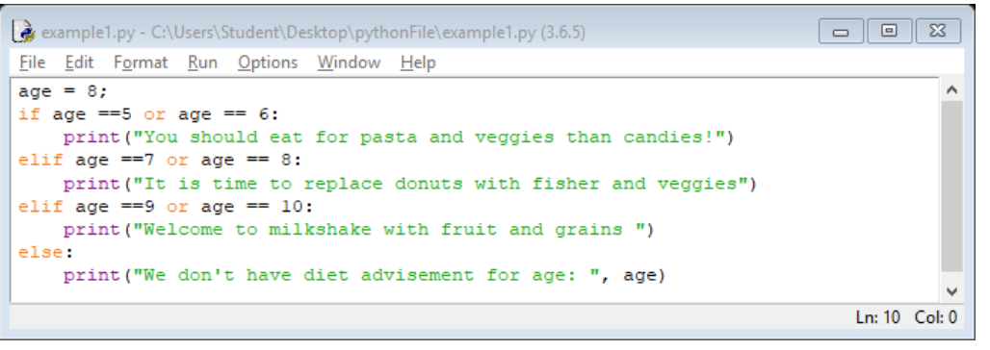
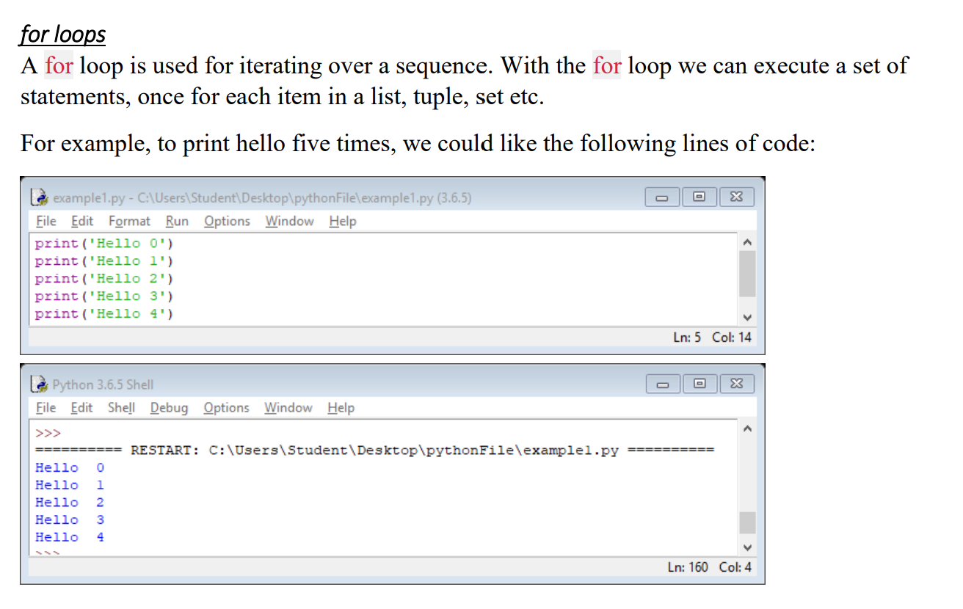
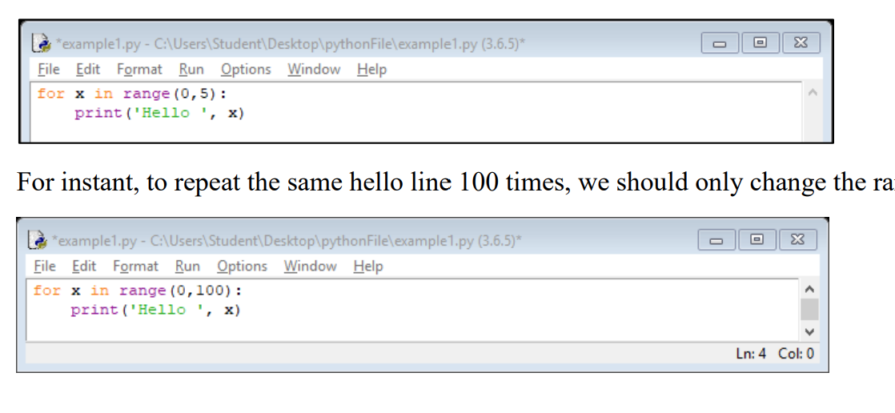
Control Flow Statement

Slide 15
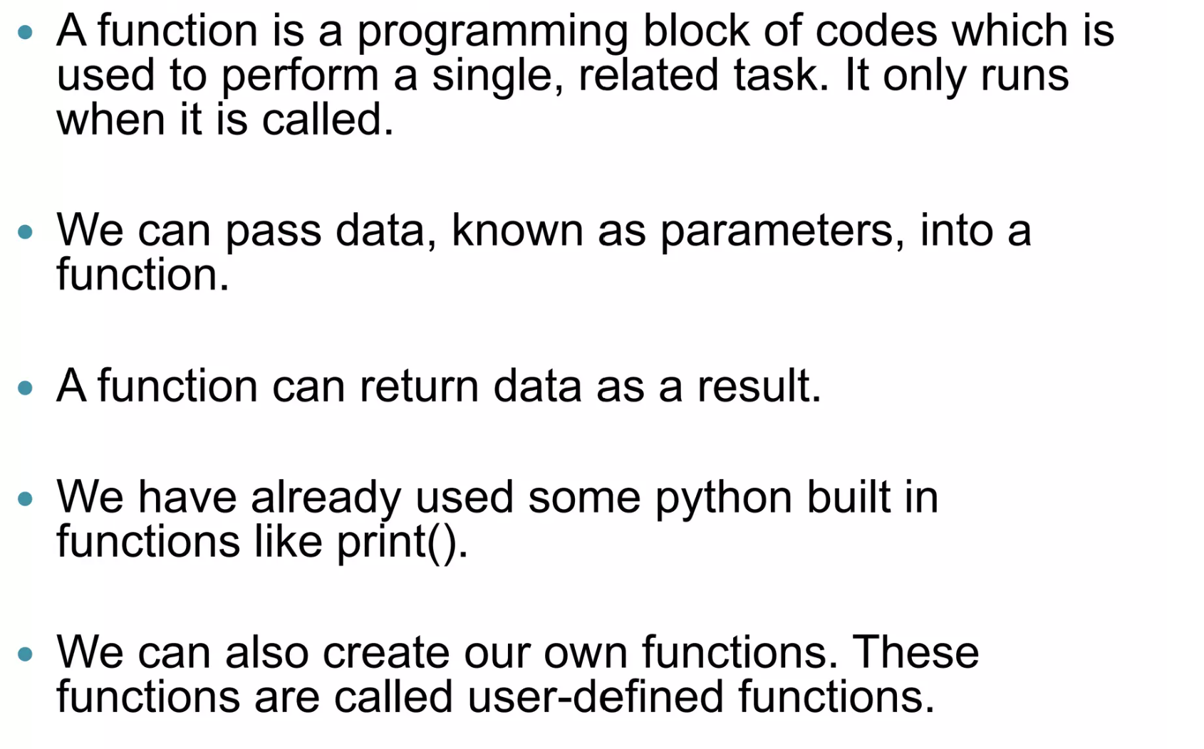
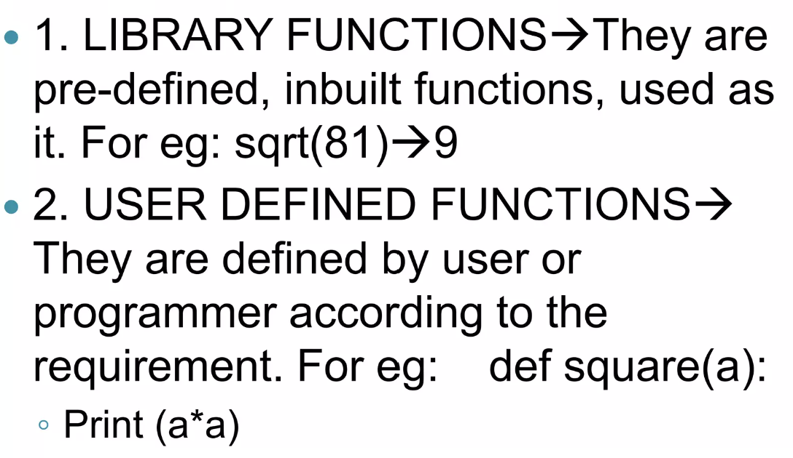
Functions
Types of Functions

